Slide 1


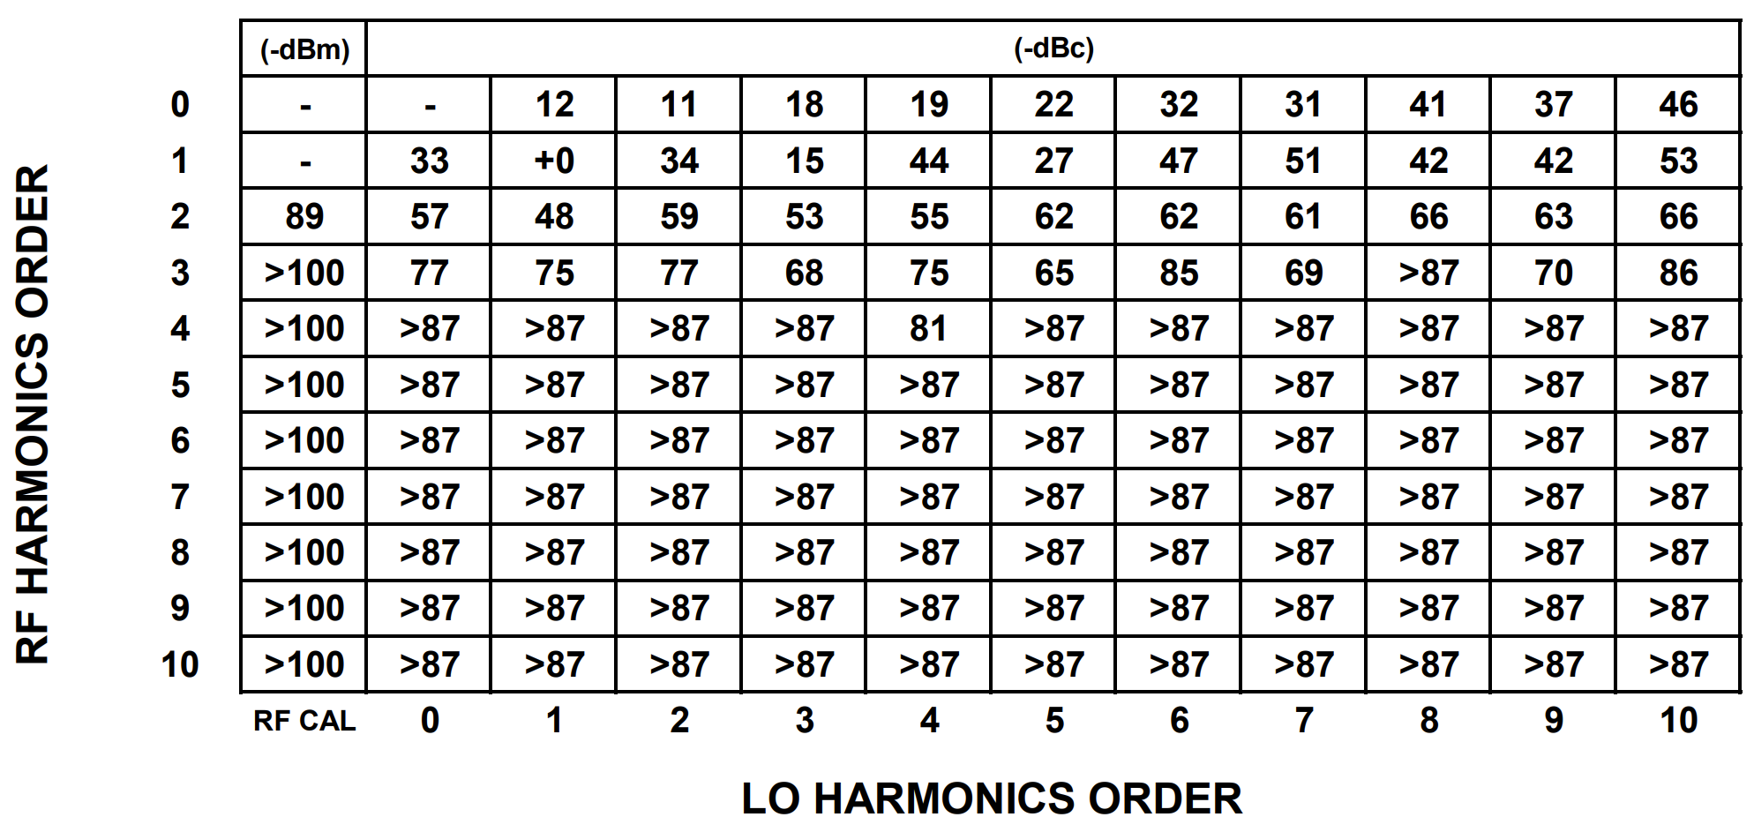
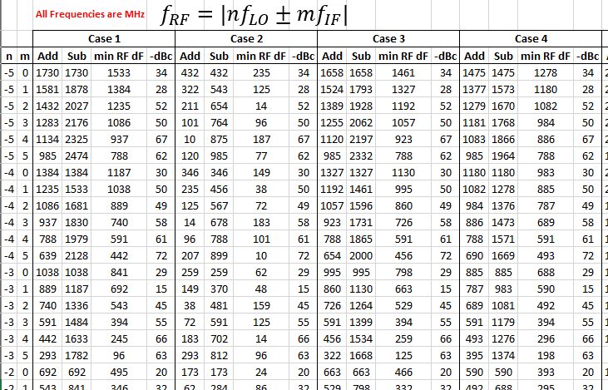
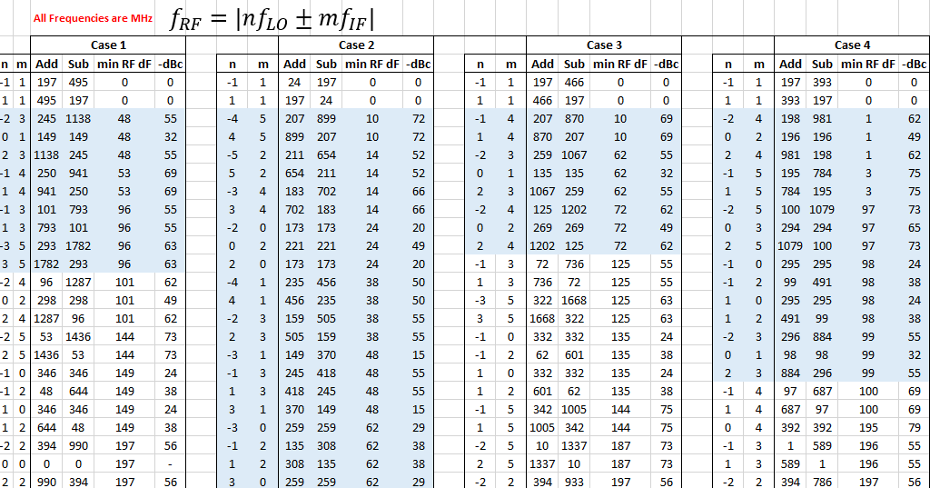
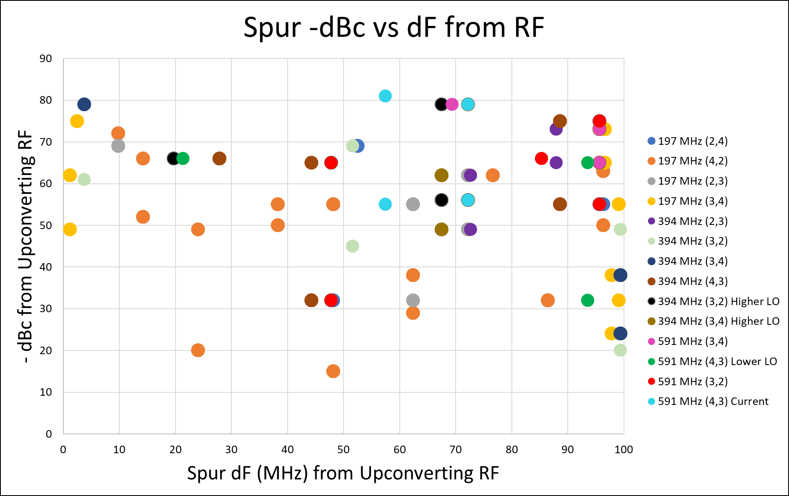
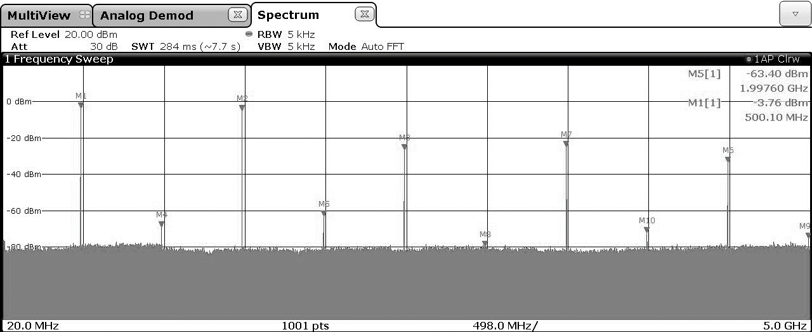
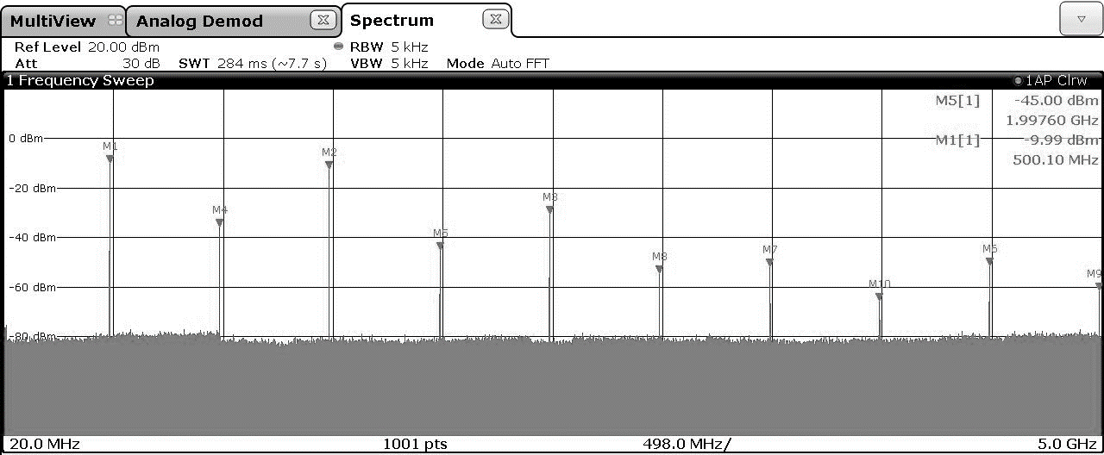
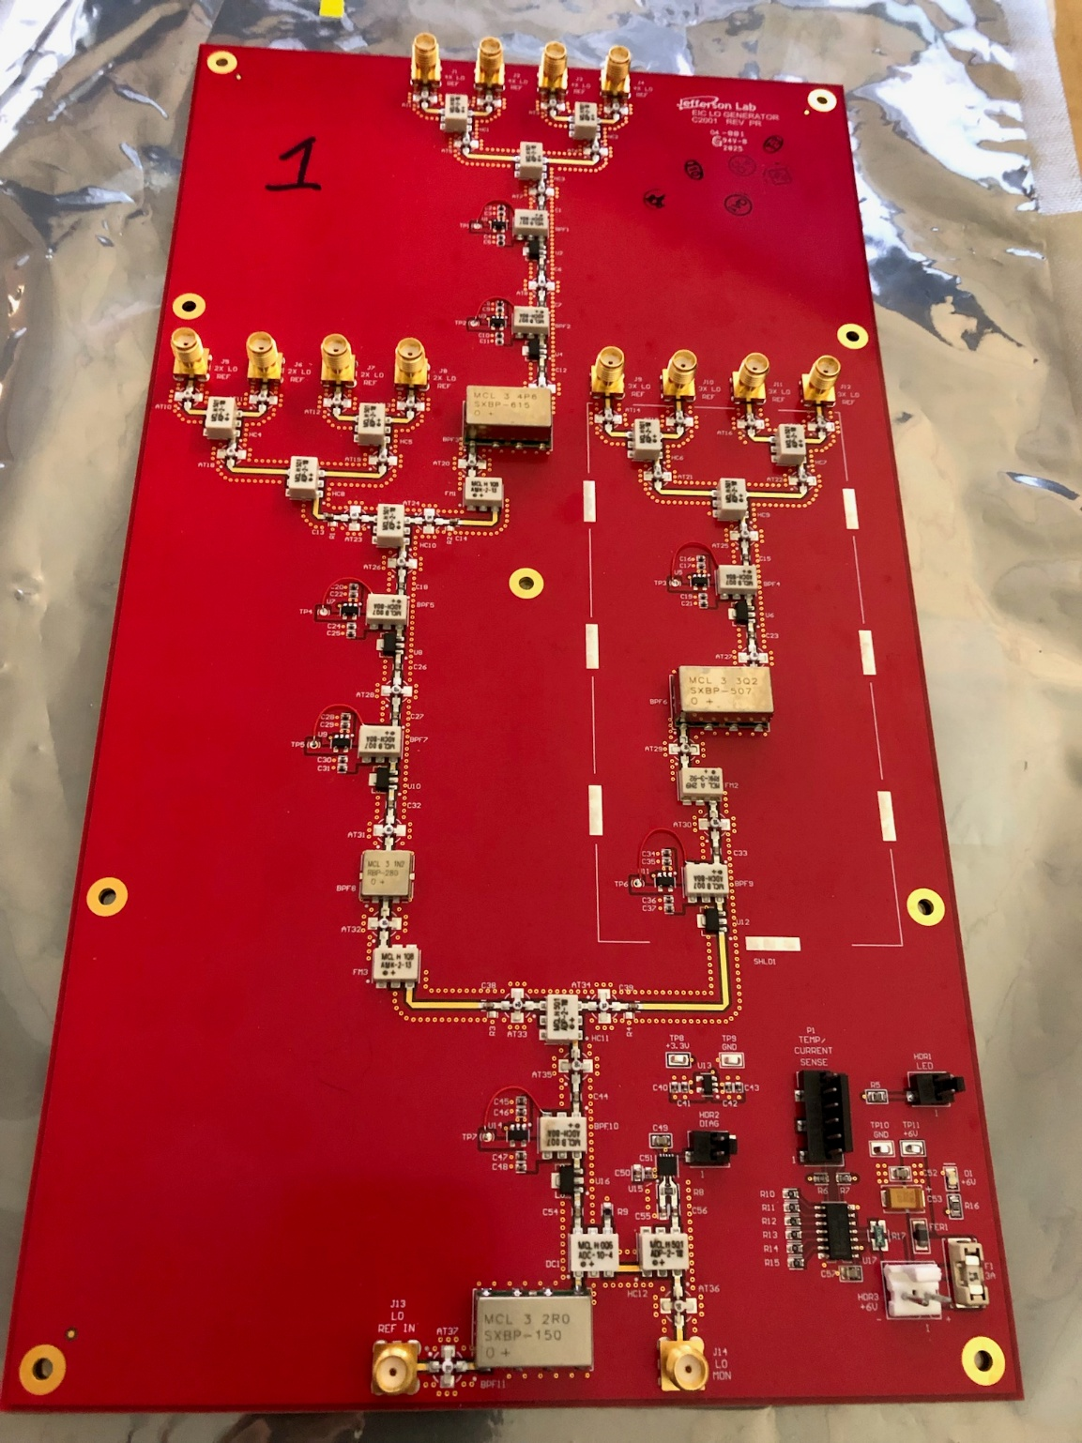
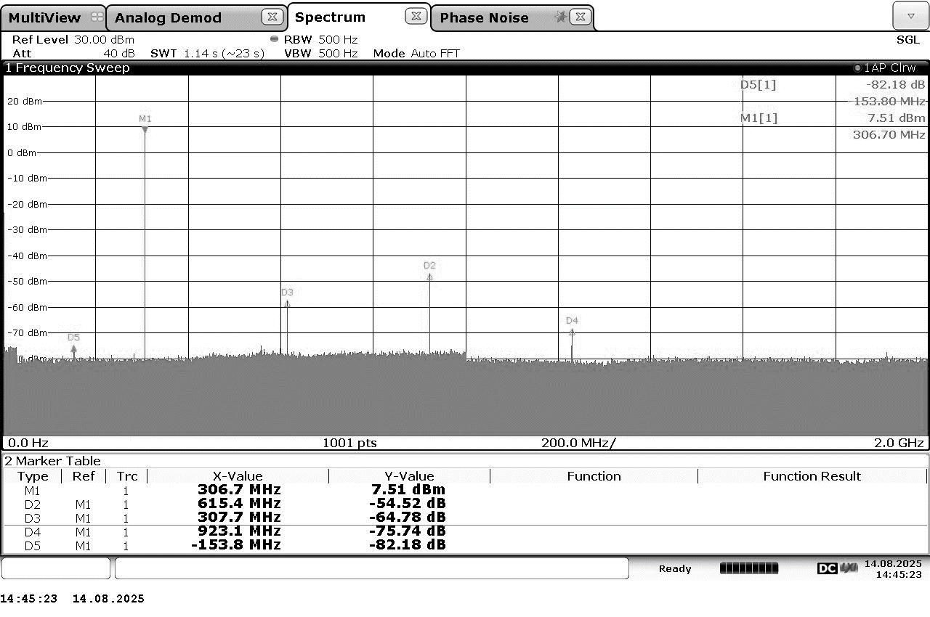
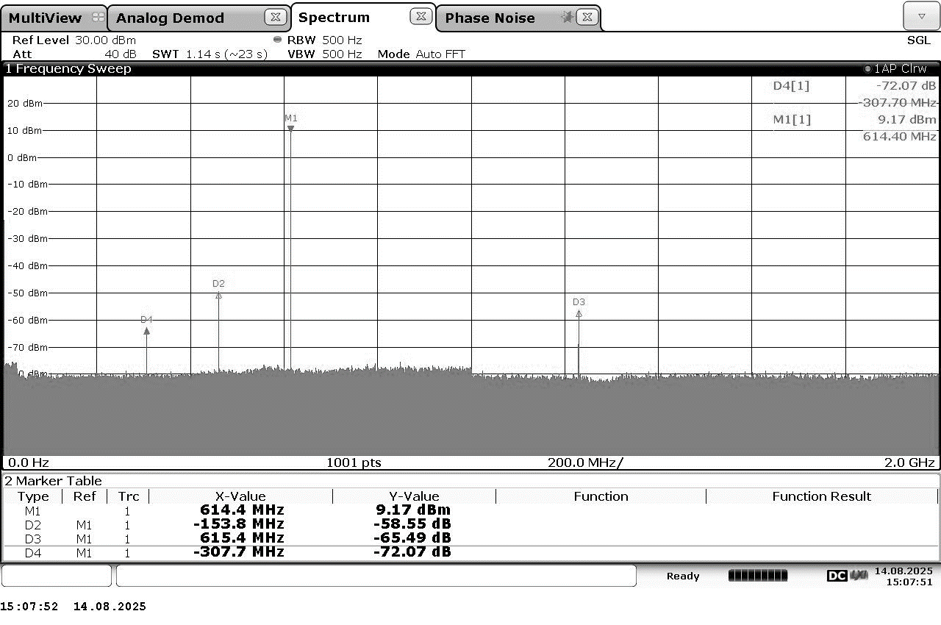
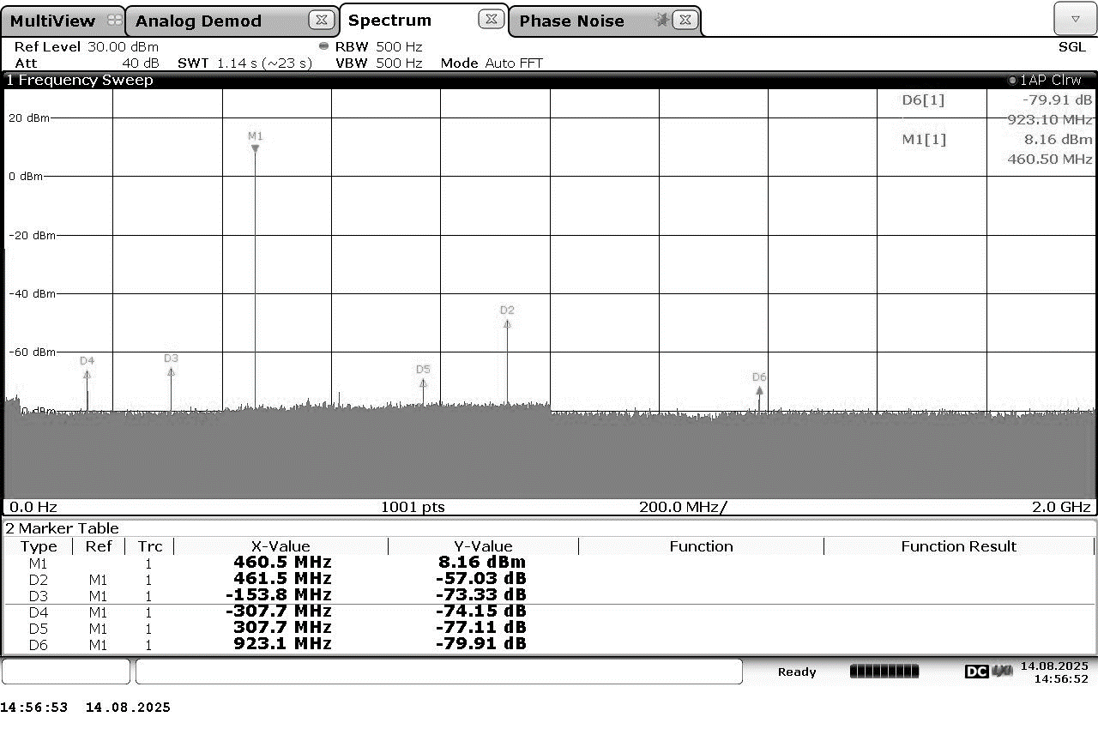

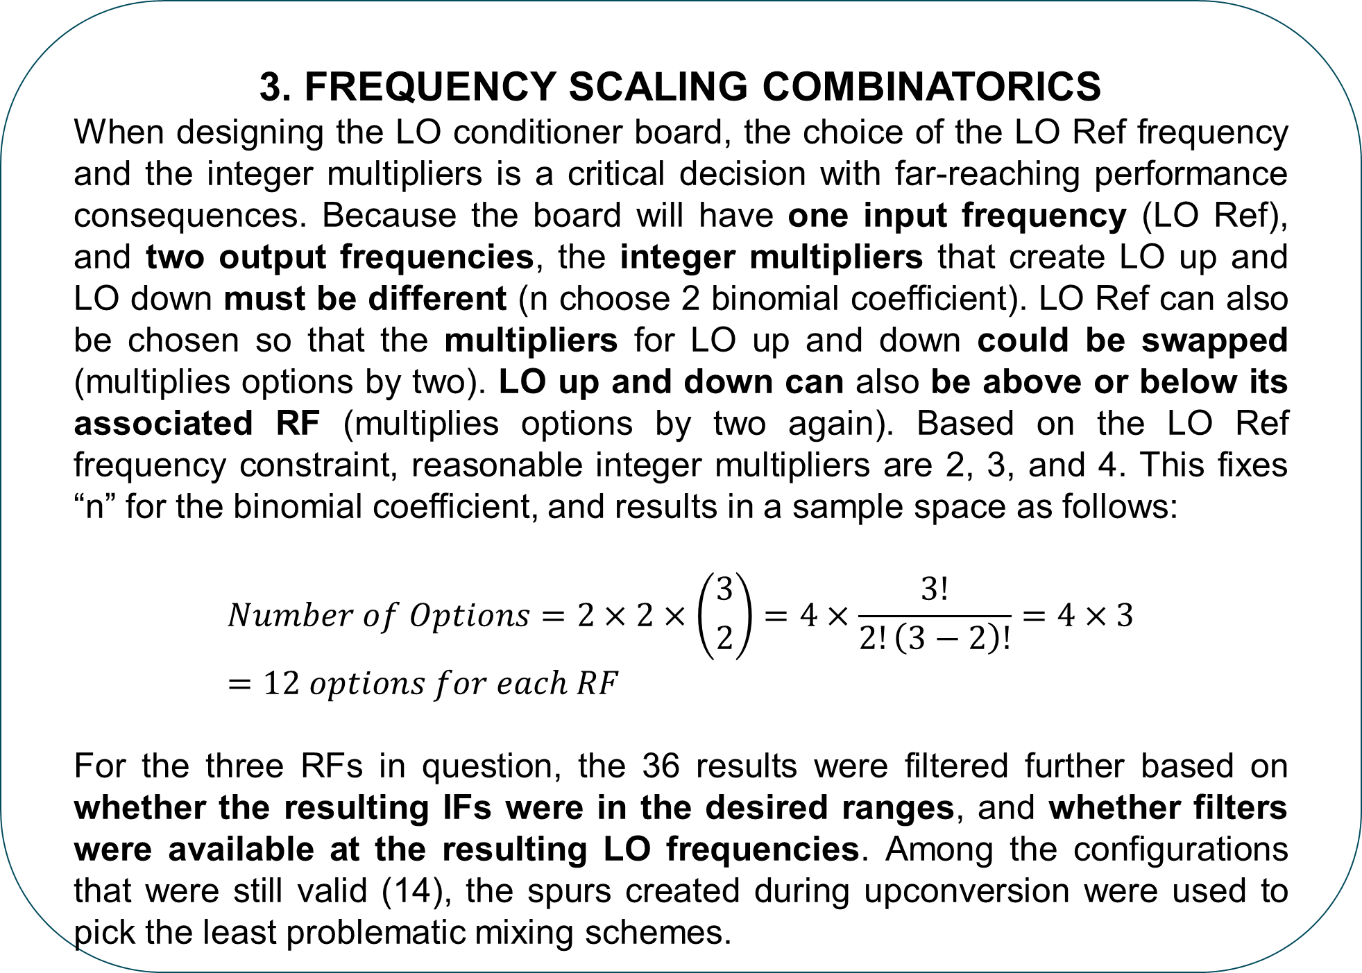

Local Oscillator Conditioner for the Electron Ion Collider
Joshua Settle & Kevin Mernick
Jefferson Lab, Newport News, Virginia, USA, Brookhaven National Lab, Upton, New York, USA
Abstract
The Electron Ion Collider is an exciting collaborative effort to advance and invest in the future of nuclear physics and accelerator science. Part of this great effort includes designing a diverse set of RF cavities and control systems, in which heterodyning still plays a fundamental role. There are multiple frequencies in the VHF and UHF bands which require up and/or down conversion, and designing one circuit board that can accommodate local oscillator (LO) signals for multiple mixing schemes was a valuable and interesting task. A combinatorics problem emerged out of this component’s constraints that required organizing a large number of cases and integrating commercial data to reveal the best design choices. Pictures of the prototypes and their performance are displayed to demonstrate its success. This poster showcases only part of the vast and impressive collaboration between Brookhaven National Laboratory and the Thomas Jefferson National Accelerator Facility.
LO Conditioner Chassis
LO Conditioner PCB
Other Block Downconverter Chassis
DAC
LO Ref
Multiplier(s)
LO Up
Σ
Multiplier(s)
LO Down
Σ
Block Downconverter Chassis (Group 2)
Downconverter PCB - 8 Ch
RF Probe Cable
RF
Σ
IF
ADC
…
…
…
1. LO Conditioner Design context
The LO conditioner board:
Accepts (does not create) a DAC-generated LO Reference (LO Ref) signal in the 0 to +3 dBm range
Scales the LO Ref frequency by two different integer multipliers to produce the two LO signals for up and downconversion (LO up and LO down)
Outputs LO up and LO down with up to four ports for each frequency in the +7 to +10 dBm range
The outputs of the LO conditioner are passed to the LO inputs on the up and downconverter boards.
$$LO_{UP OR DWN} \left(MHz\right)=C×\left(LO_{REF}±e\right) MHz,$$
$$where e is phase or frequency error \& C a constant$$
Upconverter PCB - 4 Ch (Group 2 Only)
Pre-Amp
RF
Σ
IF
DAC
…
RF
$$LO_{UP OR DWN} \left(MHz\right)=\left(C×LO_{REF}\right)±\left(C×e\right) MHz$$
…
RF
Design Context Diagram
Power
LO Ref
LO Ref
LO Ref
(C-1) * LO Ref
C * LO Ref
(C+1) * LO Ref
2. Frequency constraints
Machine Frequency ~ 78 kHz ± 200 Hz
RFs at 197 MHz, 394 MHz, and 591 MHz
Downconversion IF ~ 24 MHz
Upconversion IF ~ 140 ± 40 MHz
LO Ref < 200 MHz
Pick LO so bandpass filters are easy to acquire
Pick LO so mixing/multiplying spurs/byproducts are not problematic
Frequency
$$f_{IF}=\left|f_{LO}−f_{RF}\right|$$
Power
IF_{D}
IF_{U}
LO_{D1}
LO_{D2}
LO_{U2}
3. Frequency Scaling Combinatorics
When designing the LO conditioner board, the choice of the LO Ref frequency and the integer multipliers is a critical decision with far-reaching performance consequences. Because the board will have one input frequency (LO Ref), and two output frequencies, the integer multipliers that create LO up and LO down must be different (n choose 2 binomial coefficient). LO Ref can also be chosen so that the multipliers for LO up and down could be swapped (multiplies options by two). LO up and down can also be above or below its associated RF (multiplies options by two again). Based on the LO Ref frequency constraint, reasonable integer multipliers are 2, 3, and 4. This fixes “n” for the binomial coefficient, and results in a sample space as follows:
$$Number of Options=2×2×\left({3 \atop 2}\right)=4×\frac{3!}{2!\left(3−2\right)!}=4×3=12 options for each RF$$
For the three RFs in question, the 36 results were filtered further based on whether the resulting IFs were in the desired ranges, and whether filters were available at the resulting LO frequencies. Among the configurations that were still valid (14), the spurs created during upconversion were used to pick the least problematic mixing schemes.
LO_{U1}
RF
Frequency
Mach F (Hz) | 78192 | Frequency & Harmonics Calculations
RF |  | LO Ref | LO Down |  | LO Up |  | IF Down | IF Up | 2,3 | 2,4 | 3,4
F Des | MHz | MHz | C | MHz | C | MHz | MHz | MHz
RF1_2 | 197 | 87 | 2 | 173 | 4 | 346 | 24 | 149 | 1 | 2 | 1
RF1_5 | 197 | 43 | 4 | 173 | 2 | 86 | 24 | 111
RF1_7 | 197 | 111 | 2 | 221 | 3 | 332 | 24 | 135
RF1_10 | 197 | 74 | 3 | 221 | 4 | 295 | 24 | 98
RF2_1 | 394 | 185 | 2 | 370 | 3 | 555 | 24 | 161 | 3 | 0 | 3
RF2_3 | 394 | 123 | 3 | 370 | 2 | 247 | 24 | 147
RF2_4 | 394 | 123 | 3 | 370 | 4 | 494 | 24 | 99
RF2_6 | 394 | 93 | 4 | 370 | 3 | 278 | 24 | 117
RF2_9 | 394 | 139 | 3 | 418 | 2 | 279 | 24 | 115
RF2_10 | 394 | 139 | 3 | 418 | 4 | 557 | 24 | 163
RF3_4 | 591 | 189 | 3 | 567 | 4 | 756 | 24 | 165 | 1 | 0 | 3
RF3_6 | 591 | 142 | 4 | 567 | 3 | 425 | 24 | 166
RF3_9 | 591 | 205 | 3 | 615 | 2 | 410 | 24 | 181
RF3_12 | 591 | 154 | 4 | 615 | 3 | 461 | 24 | 130
4. Upconversion Argument
To help pick from the 14 valid mixing schemes, the upconversion spurs were counted for the first 5 orders of harmonics. Each spur was sorted by delta f from the intended RF output, and the upconverter mixer’s harmonics data was indexed to estimate the dBc in relation to the intended RF output power. All the projected spurs were plotted to visualize the best mixing scheme for each RF. Mixing schemes with the least powerful spurs furthest away from the intended RF output were chosen.
x2
BPF
Σ
x2 Output Ports
LO Ref In
BPF
Σ
x2
BPF
x4 Output Ports
MHz | JCBP | RBP | SXBP | ZABP | ZX75BP
43 |  |  |  | ZABP-45-S+
74 |  | RBP-75+ | SXBP-75+ | ZABP-73-S+ | ZX75BP-75-S+
86
93 |  | RBP-98+ |  |  | ZX75BP-98-S+
98 |  |  | SXBP-101+
99
111 | JCBP-290+ |  | SXBP-100+ | ZABP-141-S+
115
117
123 |  | RBP-135+ |  |  | ZX75BP-135-S+
130
135 |  |  | SXBP-140+
139 |  | RBP-140+ |  |  | ZX75BP-140-S+
142
147 |  |  | SXBP-150+
149
154 |  | RBP-160+ | SXBP-157+ |  | ZX75BP-160-S+
156
161 |  |  | SXBP-161R5+
163 |  |  | SXBP-162+
165 |  |  |  | ZABP-184-S+
166 |  |  | SXBP-169+
170 |  | RBP-173+
173
180 |  |  | SXBP-178+ |  | ZX75BP-188-S+
181 |  | RBP-188+
185
189
194
197 |  | RBP-204+ |  |  | ZX75BP-204-S+
205 |  |  | SXBP-202+
221 |  | RBP-220+
247 |  | RBP-253+ |  |  | ZX75BP-253-S+
278 |  | RBP-280+ |  |  | ZX75BP-263-S+
279
295 |  |  | SXBP-300+
332 |  |  | SXBP-350+ |  | ZX75BP-400-S+
346 |  | RBP-400+
370 |  |  | SXBP-375+
394
410 |  | RBP-415+ |  | ZABP-450-S+
418 |  |  | SXBP-425+ |  | ZX75BP-440-S+
425
461 |  | RBP-440+
494 |  |  | SXBP-507+ | ZABP-495-S+
555 |  |  |  | ZABP-550-S+
557
567 |  |  | SXBP-615+
591 |  |  |  | ZABP-587-S+
615 | JCBP-900+ |  |  | ZABP-598-S+ | ZX75BP-750-S+
756 |  |  | SXBP-707+ | ZABP-650-S+
x3
BPF
x3 Output Ports
5. Multipliers (left) VS MIXERS (RIGHT)
Although frequency multipliers do scale phase noise w/ frequency, they are more compact and require fewer supporting components (reduces board size/complexity/cost). Multipliers also dampen the nearest harmonics more than mixers.
Simplified Topology
$$Phase error °(e)=jitter \left(s\right)×360°×f (Hz)$$
 | Phase Noise Measurements - 153.8 MHz input at 3 dBm - Ctrl is Signal Generator Directly to Signal Analyzer, 1 Hz to 1 MHz, 5% RBW
 | Ctrl | 1 |  |  | 2 |  |  | 3 |  |  | 4 |  |  | 5
 | X1 - Sig Gen | X2 OUT (dBm) | X3 OUT (dBm) | X4 OUT (dBm) | X2 OUT (dBm) | X3 OUT (dBm) | X4 OUT (dBm) | X2 OUT (dBm) | X3 OUT (dBm) | X4 OUT (dBm) | X2 OUT (dBm) | X3 OUT (dBm) | X4 OUT (dBm) | X2 OUT (dBm) | X3 OUT (dBm) | X4 OUT (dBm)
Level In (dBm) | 2.75 | 7.65 | 8.32 | 9.05 | 7.32 | 7.86 | 8.71 | -10.80 | 8.01 | 8.60 | 7.39 | 8.07 | 8.86 | 7.67 | 8.30 | 9.07
Int Noise (dBc) | -88.73 | -83.70 | -80.12 | -77.66 | -82.41 | -78.72 | -75.96 | -82.12 | -79.43 | -76.32 | -83.19 | -78.78 | -76.23 | -83.26 | -79.12 | -75.98
PM (m°) | 2.97 | 5.29 | 7.99 | 10.61 | 6.14 | 9.39 | 12.90 | 6.35 | 8.65 | 12.38 | 5.61 | 9.33 | 12.50 | 5.57 | 8.97 | 12.88
FM/AM (Hz) | 7.565 | 16.17 | 24.36 | 32.74 | 16.19 | 20.08 | 32.85 | 37.93 | 24.30 | 32.57 | 16.14 | 24.05 | 32.73 | 16.11 | 24.33 | 32.59
Jitter (fs) | 53.583 | 47.81 | 48.10 | 47.88 | 55.44 | 56.50 | 58.25 | 57.30 | 52.10 | 55.90 | 50.70 | 56.15 | 56.44 | 50.26 | 53.98 | 58.15
PM Ratio | 1 | 1.78 | 2.69 | 3.57 | 2.07 | 3.16 | 4.34 | 2.14 | 2.91 | 4.17 | 1.89 | 3.14 | 4.21 | 1.88 | 3.02 | 4.34
Expected | 1 | 2 | 3 | 4 | 2 | 3 | 4 | 2 | 3 | 4 | 2 | 3 | 4 | 2 | 3 | 4
Prototype Picture
LO REF x2 SPECTRUM
LO REF x4 SPECTRUM
LO REF x3 SPECTRUM
6. Filter availability
SXBP+ and RBP+ were found to be the most suited for this design (best coverage).
7. Performance
For 591 MHz case:
All spurs more than 150 MHz away from intended output
All spurs no more than -55 dBc (carrier being the intended output)
x2 output average NF = 4.73 dB
x3 output average NF = 5.43 dB
x4 output average NF = 6.73 dB
Phase noise on par with frequency multiplication of input
REFERENCES
[1]“Mini Circuits - Global Leader of RF and Microwave Components,” www.minicircuits.com. https://www.minicircuits.com/
[2] Rohde & Schwarz GmbH & Co KG, “Industry-leading technology company,” Industry-leading technology company | Rohde & Schwarz, https://www.rohde-schwarz.com/us/home_48230.html
*Authored by JSA, LLC under U.S. DOE Contract DE-AC05- 06OR23177 and DE-SC0005264. The U.S. Govt. retains a non-exclusive, paid-up, irrevocable, worldwide license to publish or reproduce this for U.S. Govt. purposes.
This work was supported by the EIC Project and the U.S. Department of Energy, Contract DE-SC0012704.

